Slide 1
Problem Statements for double pipe heat exchanger
2023

Slide 2
Problem Statements for double pipe heat exchanger

Slide 3
Problem Statement for Double Pipe Heat Exchanger
for group number 1 to 10
In a marine application, x kg/s of engine oil is to be cooled from T_{in} °C to T_{out} °C using seawater available at 30°C. The maximum allowable temperature rise for seawater may be taken as 12-15°C. Typical fouling resistance is 0.00018 m²·K/W for engine oil and 0.0001 m²·K/W for water and the maximum allowable pressure drop is 65 kPa (≈10 psig) for water and 80 kPa (≈ 15 psig) for oil.
x = flow rate = group number for groups 1 to 10.
T_{in} and T_{out} for the corresponding value of x are given in the next slide.
Design a double-pipe heat exchanger by deciding on a suitable hairpin arrangement.
The thermal conductivity of the exchanger material (steel/iron) is 52 W/m·K.

Slide 4
Group number | Flow rate of oil = x kg/s | Tin °C | Tout °C
1 | 1 | 125 | 55
2 | 2 | 120 | 55
3 | 3 | 120 | 50
4 | 4 | 120 | 60
5 | 5 | 120 | 65
6 | 6 | 125 | 60
7 | 7 | 120 | 70
8 | 8 | 125 | 65
9 | 9 | 125 | 50
10 | 10 | 120 | 75

Slide 5
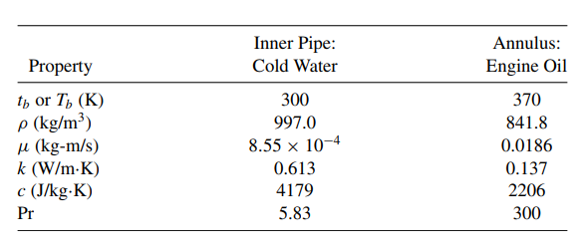

Slide 6
Problem Statement for Double Pipe Heat Exchanger
for group number 11 to 21
Z kg/hr of 57⁰API gasoline is cooled from T_{in} °C to T_{out} °C by heating 42⁰API kerosene from 30 °C to 45 °C. The allowable pressure drop is 0.7 bar for both tube and shell sides. A minimum dirt factor of 0.004 m²·K/W may be assumed.
Design a suitable double-pipe heat exchanger (with hairpin arrangement) and present the drawings in a form that can be sent to the fabricator.
You may refer to the Appendix of Process Heat Transfer by Kern for data on thermo-physical properties and select alloy steel as the material of construction

Slide 7
Group number | Z (kg/hr ) Gasoline | Tin °C | Tout °C
11 | 568 | 70 | 35
12 | 563 | 75 | 35
13 | 557 | 65 | 45
14 | 552 | 65 | 40
15 | 548 | 70 | 40
16 | 544 | 60 | 35
17 | 540 | 65 | 35
18 | 537 | 60 | 40
19 | 533 | 70 | 45
20 | 530 | 60 | 35
21 | 528 | 68 | 42

